Slide 1
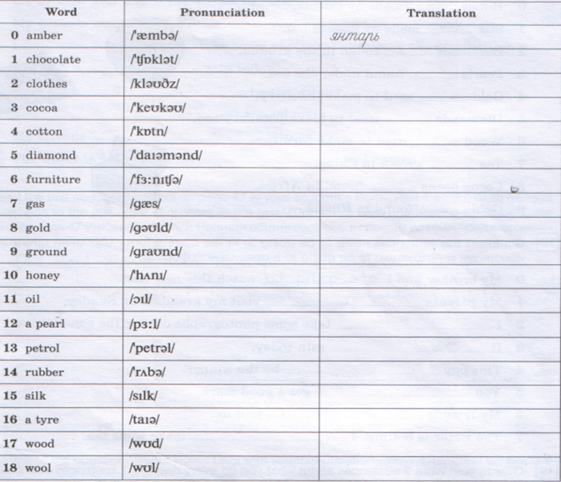
Write the translation of the words and read

Slide 2
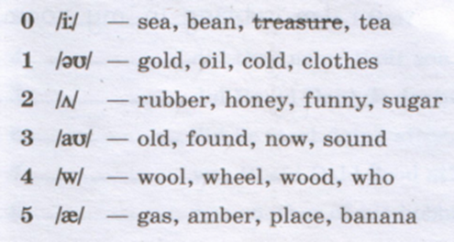

Slide 3
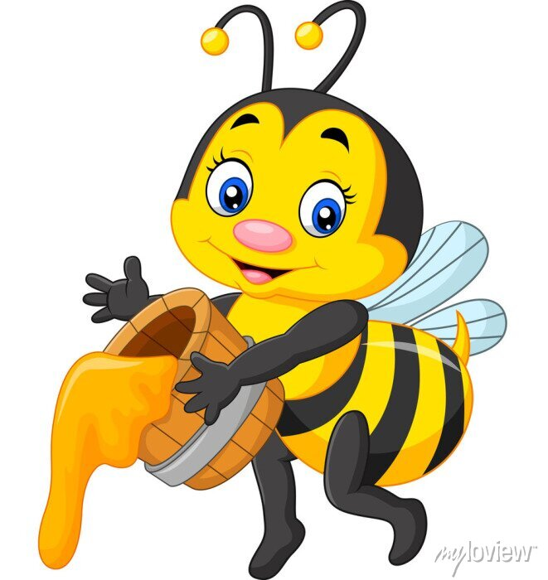
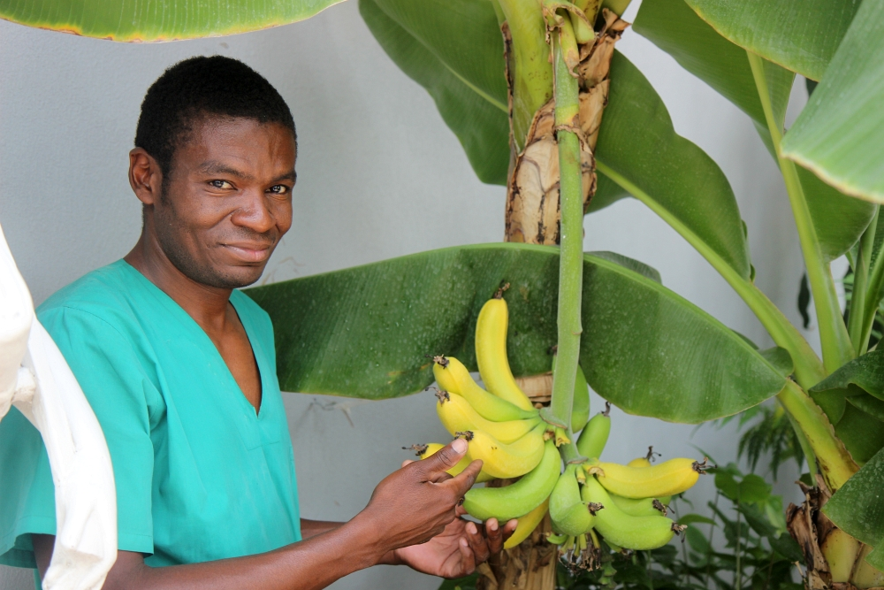
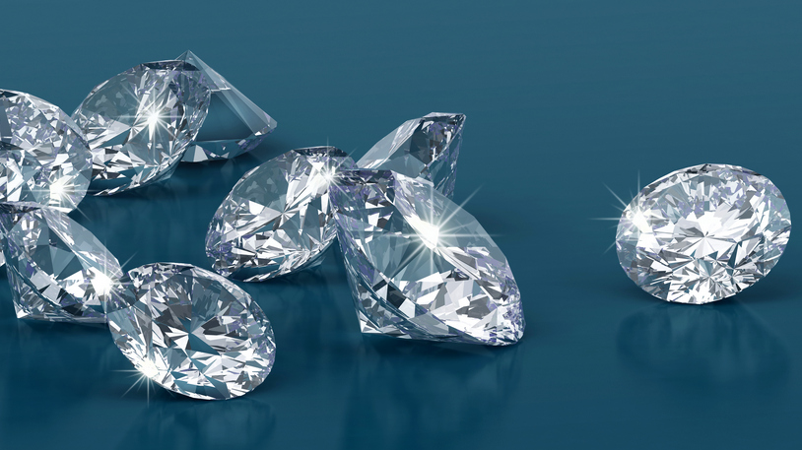
Translate into Russian
A
Diamonds are found in the ground
B
Honey is made by bees
Bananas are grown on palm trees
C

Slide 4
Remember the rules
Is/are grown
Is/are found
Is/are made by
Is/are used for

Slide 5
Choose and write sentences
Is/are grown on trees
Is/are grown on plants
Is/are found in the ground
Is/are found in the sea
Is/are made by insects
Is/are used for making electricity
Pearls …………………………………………………………..
Cocoa…………………………………………………………….
Salt……………………………………………………………..
Nuts…………………………………………………………
Oil………………………………………………………..
Silk………………………………………………………………..
Oil and gas………………………………………………
Cotton…………………………………………………….

